Slide 1
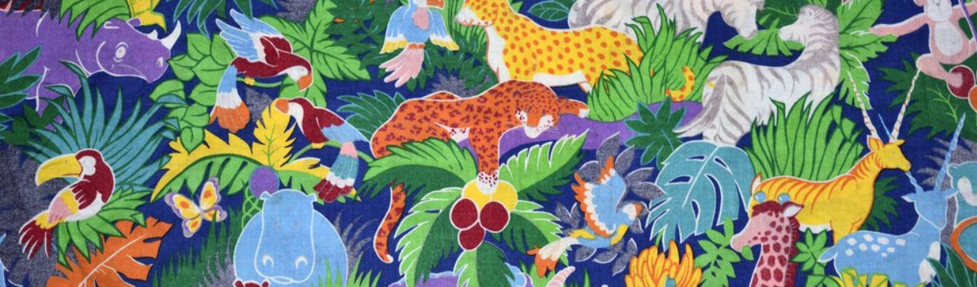
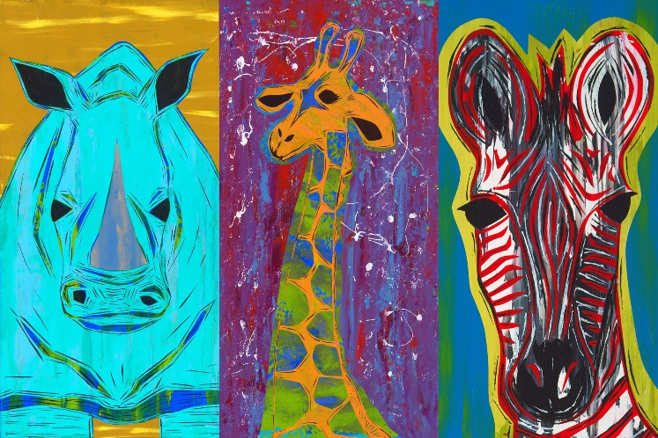
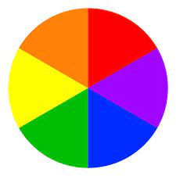
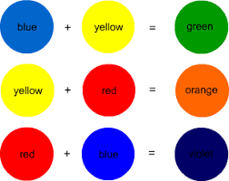
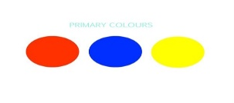
Knowledge Organiser Year 2 Art: Going on Safari Concept Colour
Key Vocabulary
Primary Colours | All other colours are made from these. They cannot be made by mixing other colours. Red, blue and yellow are primary colours.
Secondary colours | A colour made by mixing two primary colours. Red and yellow = orange Red and blue = purple Yellow and blue = green
Shade | To make a shade you add black which darkens the colour.
Tint | To tint a colour you add white which makes the colour lighter.
Safari | A trip to watch, photograph, or hunt wild animals in their natural environment:
This is artwork of safari animals but using different colours and shades.
Colour Wheel
Secondary Colours
Primary Colours

Slide 2
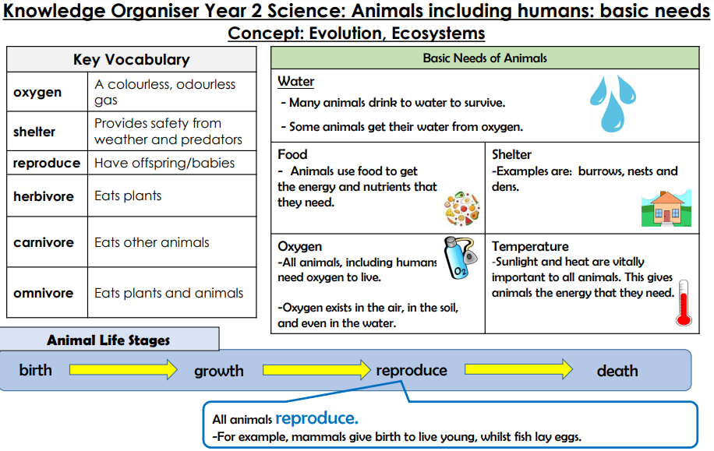

Slide 3
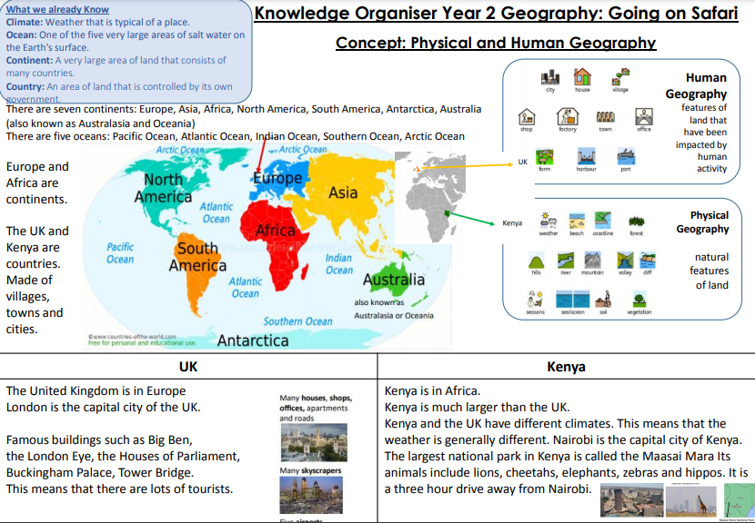

Slide 4
