Slide 1
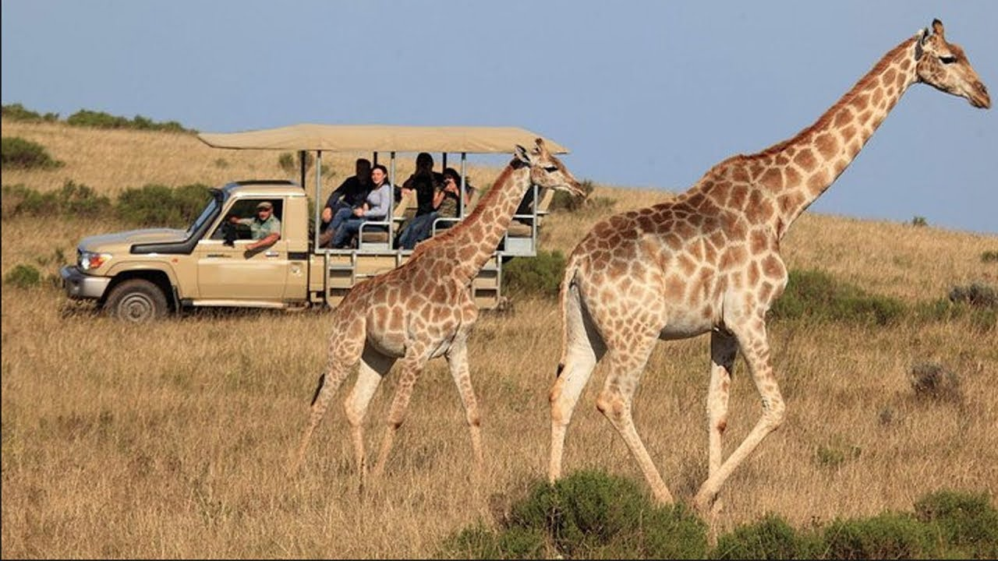
Dobwalls Primary School Medium Term Plan Year 2 Autumn 1st half
English
In the first few weeks, we will be focusing on getting to know where the children are in their learning. We will look at spellings, reading, handwriting. We will begin our English lessons by writing a persuasive piece “Move to Kenya,” which is linked to our topic and geography. We will then move onto our fiction unit which is a story with a character flaw, The Hare and the Tortoise. We will learn the text off by heart using a story map and short writing activities. The children will then write their own character flaw story.
In addition to this, your child will take part in a daily spelling session or will go into their RWI group to continue their phonics learning. If your child is part of this group, please ensure that they are following up on the work carried out in the classroom using the sound sheets and reading books that will be sent home. The books have instructions to follow to help you and your child.
Please spend time listening to your child read and sign reading diaries.
We will also practice handwriting regularly and complete a whole class reading session.
Mathematics
In maths, we will continue the children's learning from year 1 where we will focus on place value where we will learn to; count forwards and backwards within 20 before moving onto 50, identify tens and ones in numbers to 50, compare numbers to 50 and count in 2s, 5s, 10s and 3s. We will then move onto addition and subtractions where we will learn to add ones and tens before moving onto adding two 2-digit numbers. This will involve the children using concreate materials (apparatus) and moving onto pictorial representations (jottings).
We will also practice our 2, 5 and 10 times tables daily using songs.
Going on Safari
Religious Education
Our RE lessons this half term, will explore the question: Who is a Muslim and how do they live? The children will recap their previous learning about Muslims and build on this by learning about what is important to Muslims, what they think about God, who was the Prophet Muhammad and why he is important and what difference worshiping God makes to Muslims.
Science
Our science topic for this half term is animals including humans. We will explore what animals and humans need to survive, that animals and humans have offspring which turn into adults. During this unit of work, we will also learn about the different stages of a humans life. We will learn about this by using changes that have happened in the children's lives so far such as being a baby, starting school etc.
Geography
In geography, we are learning about the similarities and differences between the United Kingdom and Kenya. We will look at physical and human features of both countries and make comparisons. We will also learn about what life is like in Kenya. In addition, we will learn the seven continents and five oceans linking this to which continents the two countries are in and which oceans surround them.
Creativity: Art
For art this half term we will learn about the primary and secondary colours as well as explore different shades of colours. We will then apply our knowledge of colour to create and design our own safari animals.
Computing
This half term we will have the computers on a rota, this will enable us to learn how to use the computers by typing and searching the internet as well as learning how to programme.
RSE
In RSE, we will look at keeping and staying safe. We will learn the reasons to make sure our laces are tied, how to tie our laces, rules to keep ourselves and others safe and understanding the differences between safe and risky choices.
PE
Our day for PE is Wednesday, the children need to come to school in their PE kits and stay in them all day.

