Slide 1
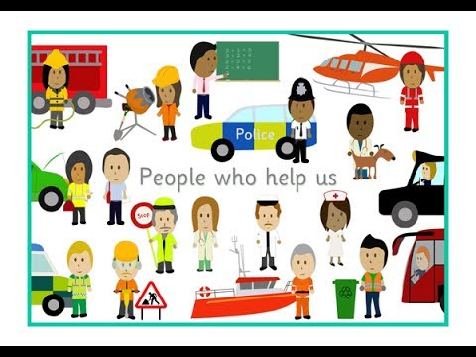
Dobwalls Primary School Medium Term Plan EYFS Summer 2nd half
Literacy
We will begin the half term by introducing our new story ‘Handa’s Surprise.’ This is a story from Africa and will enable the children to explore another culture. The children will learn the story with a text map and have a go at writing their own version of the story. Our next focus text will be ‘Sally and the Limpet.’ This text will link in with our learning about the seaside and coastguards as well as the medical profession. Children will have lots of opportunities for ‘have a go writing.’ Our daily phonics sessions will continue in groups to suit the specific needs of the children.
Mathematics
In maths we will be continuing to focus our number work on numbers to 20. We will begin by exploring doubling and halving within this range. Children will take part in adult led sessions to develop their abilities to solve halving and doubling problems. They will also have the opportunity to use these skills during their continuous provision where activities will be designed using stimulating resources to practice these skills. We will move on to investigating odd and even numbers to 20; once again there will be a combination of adult led and child led activities. EYFS children will also engage with measuring weight and capacity.
Personal, Social and Emotional Development
This half term we will be focussing on transition. We will look at different changes that happen and explore strategies to manage new experiences. The children will have plenty of opportunities to meet their new Year 1 teachers and get to know their new classroom and learning environment. They will start to familiarise themselves with their new routines and reflect on their journey since they started school in September.
Looking after ourselves and others
Physical Development
We will be building upon our daily handwriting sessions to ensure that letter formation and pencil control are now secure. In our P.E sessions we will begin by taking part in a range of team games and competitions in preparation for our sports day event in the summer term. Children will once again be taught to work as part of a team to reach an end goal. Our events will focus on the development of gross motor skills; balance, co-ordination, jumping with control and moving in a range of ways with control.
Communication and language
In EYFS we will continue to develop children’s language and vocabulary through weekly story and rhyme focuses. Children will be given the opportunity to talk in whole class and smaller group discussions about their own experiences.
Understanding the world
The children will be finding out about the people who look after us. From Doctors, Coastguards and Police Officers to parents and relatives. We will explore the roles of professionals and family members and how they impact on the children’s lives. There will be a focus on ‘keeping healthy’ where we will look at things like exercise, healthy eating and cleaning our teeth. We will also be exploring different cultures through a range of stories like ‘Handa’s Surprise’ and ‘Amazing Grace.’
Expressive Arts and Design
Our role play enhancement will be transformed into a beach cafe, and later on a Lifeboat Station. This will enable children to act out real life experiences and bring to life the new topic based vocabulary that they have learnt. There will be lots of opportunities to explore creative artistic techniques such as sand art, printing and sculpting. We will be learning some new songs based on the sea which children will be able to change and adapt to make their own.
Wild Tribe
This half term we will be developing independence skills and focussing on the Characteristics of Effective Learning. Children will be engaging in open ended tasks to give them the opportunity to make decisions and work as a team.

